Slide 1
DIGITAL PORTFOLIO
STUDENT NAME : m.ashok raja
REGISTER NO : 24131041802521006
NM ID : asanm10424cs24
COLLEGE NAME : JAWAHAR SCIENCE COLLEGE

Slide 2
PROJECT NAME
User registration form

Slide 3
AGENDA
8
2
3
4
5
6
7
1
Project overview
End users
Tools and technologies
Portfolio Design and Layout
Features and Functionality
Results and screen shot
Conclusion
Problem statement

Slide 4
Problem Statement
Many websites and applications require a way to register users before providing access to services.
Without a user registration system, it becomes difficult to manage users, collect necessary information, and secure data. The problem is to design a simple, interactive, and user-friendly registration form that captures user information effectively.

Slide 5
Project overview
This project focuses on creating a User Registration Form using HTML, CSS, and JavaScript.
HTML will be used for structuring the form (input fields, labels, buttons).
CSS will be used for styling to make it responsive and visually appealing.
JavaScript will handle form validation (e.g., checking if all required fields are filled, verifying email format, password strength, etc.).

Slide 6
End users
Website Visitors: Individuals signing up for an account.
Web Application Owners:
Admins who require user data for authentication, personalization, and management.
Developers: As a learning project for beginners to practice front-end development.

Slide 7
Tools and technologies
HTML5 - For structuring the form.
CSS3 - For styling and responsive design.
JavaScript (Vanilla) - For client-side validation.
Optional Tools: VS Code (IDE), Browser DevTools, GitHub for version control.

Slide 8
Portfolio Design and Layout
Header: Project title "User Registration Form".
Form Section:
Input fields: Full Name, Email, Username, Password, Confirm Password, Gender, Date of Birth.
Submit & Reset buttons.
Validation Messages: Inline error/success messages.
Styling:
Centered form box with soft shadows.
Responsive design for desktop and mobile.
Consistent font and color scheme.

Slide 9
Features and Functionality
Form Fields: Collects essential user data.
Validation:
Required field check.
Email format validation.
Password strength check.
Confirm password match.
Responsive Layout: Works on mobile and desktop.
User Experience: Clear error messages, styled form, smooth interactions.

Slide 10
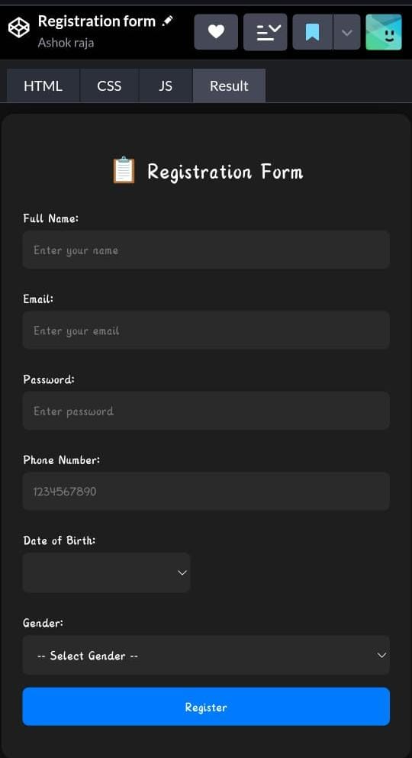
RESULT and screen shot
* Successfully developed a working registration form that validates user inputs.
* Improved user experience through styling and feedback.
* Demonstrated frontend development skills in HTML, CSS, and JavaScript

Slide 11
Conclusion
The project provided hands-on experience in building and validating a web form.
It highlights the importance of form validation for user experience and security.
This user registration form can serve as a foundation for integrating with a backend system to
store user data and create complete authentication workflows.

